Slide 1

Customer Shopping Behavior Analysis
Uncovering insights from transactional data to drive strategic business decisions.

Slide 2


Project Overview
Analyze Data
Uncover Insights
3,900 purchases across categories.
Spending patterns, segments, preferences.
Guide Decisions
Strategic business growth.

Slide 3

Dataset Summary
Data Points
Missing Data
Rows: 3,900
37 values in Review Rating
Columns: 18
Key Features
Customer demographics
Purchase details
Shopping behavior

Slide 4
Exploratory Data Analysis (Python)
01
02
03
Data Loading & Exploration
Missing Data Handling
Column Standardization
Imputed Review Rating with median by category.
Renamed to snake_case for readability.
Pandas for import, df.info() and .describe() for summary.
04
05
Feature Engineering
Database Integration
Created age_group and purchase_frequency_days.
Loaded cleaned data to PostgreSQL for SQL analysis.

Slide 5

Data Analysis (SQL)
Key Business Questions Answered:
Revenue by Gender
Female: $75,191, Male: $157,890
High-Spending Discount Users
839 customers identified.
Top 5 Products by Rating
Gloves (3.86), Sandals (3.84), Boots (3.82).
Shipping Type Comparison
Standard: $58.46, Express: $60.48.

Slide 6
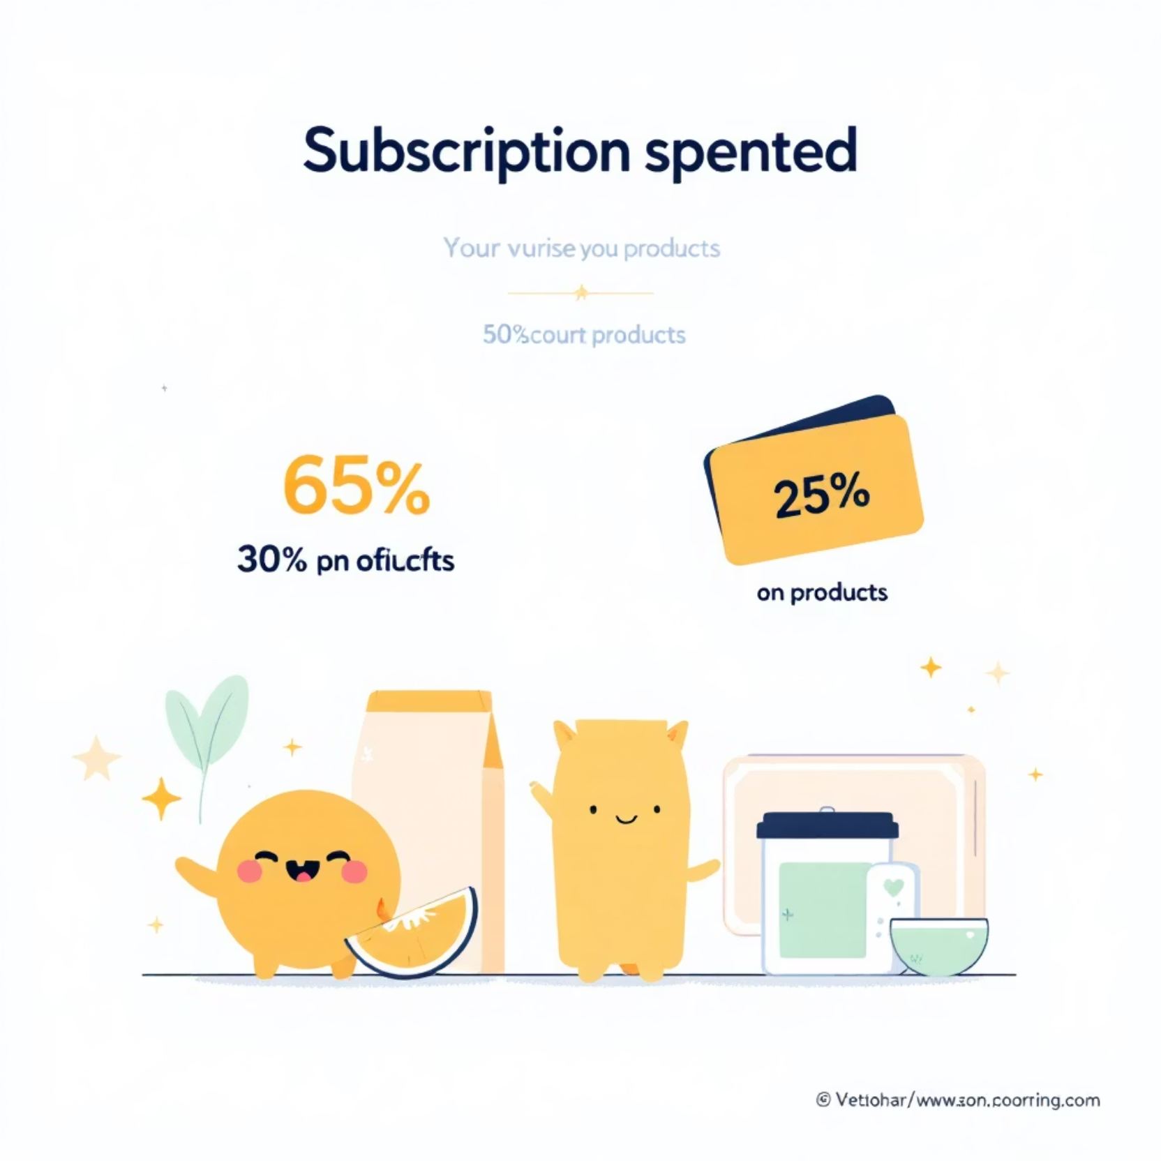
Subscription & Discount Insights
Subscribers vs. Non-Subscribers
Subscribers: 1,053 customers, Avg Spend: $59.49
Non-Subscribers: 2,847 customers, Avg Spend: $59.87
Discount-Dependent Products
Hat (50%), Sneakers (49.66%), Coat (49.07%)

Slide 7



Customer Segmentation
New
83 Customers
Loyal
3,116 Customers
Returning
701 Customers

Slide 8
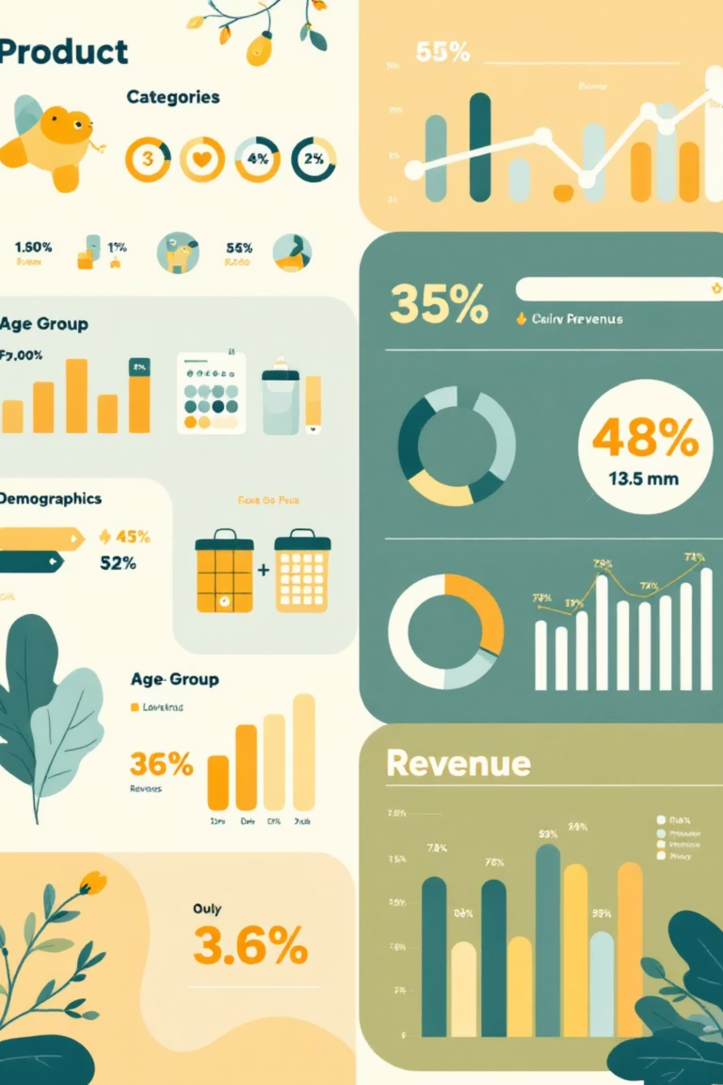
Product & Age Group Analysis
Top Products per Category
Revenue by Age Group
Young Adult: $62,143
Accessories: Jewelry, Sunglasses, Belt
Middle-aged: $59,197
Adult: $55,978
Clothing: Blouse, Pants, Shirt
Senior: $55,763
Footwear: Sandals, Shoes, Sneakers
Outerwear: Jacket, Coat
Repeat Buyers & Subscriptions
958 repeat buyers are subscribers.

Slide 9
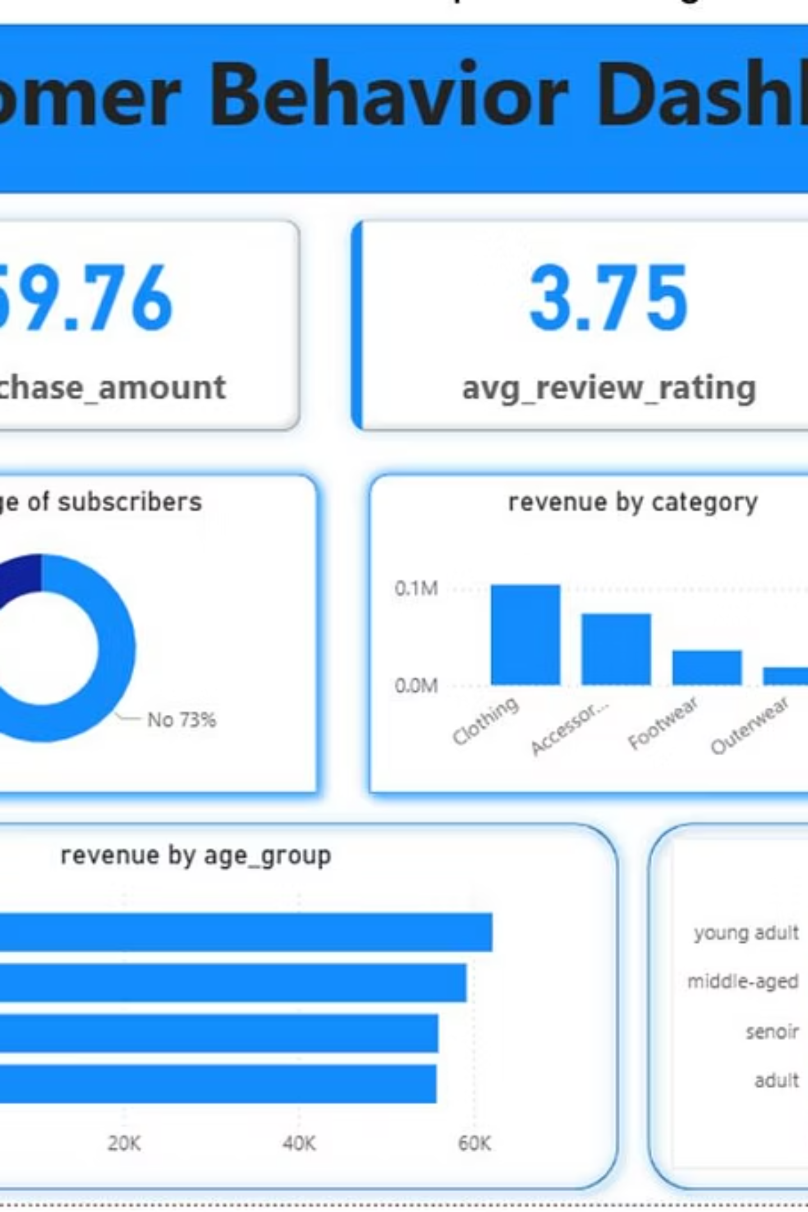
Power BI Dashboard
Interactive visualizations for key insights.
A comprehensive view of customer shopping behavior.

Slide 10
Business Recommendations
Boost Subscriptions
Promote exclusive benefits.
Customer Loyalty Programs
Reward repeat buyers.
Review Discount Policy
Balance sales with margin control.
Product Positioning
Highlight top-rated products.
Targeted Marketing
Focus on high-revenue age groups.

